Slide 1
Bug
The source code use the ground truth in RPN, and our multimodal architecture just promote this behavior.

Slide 2
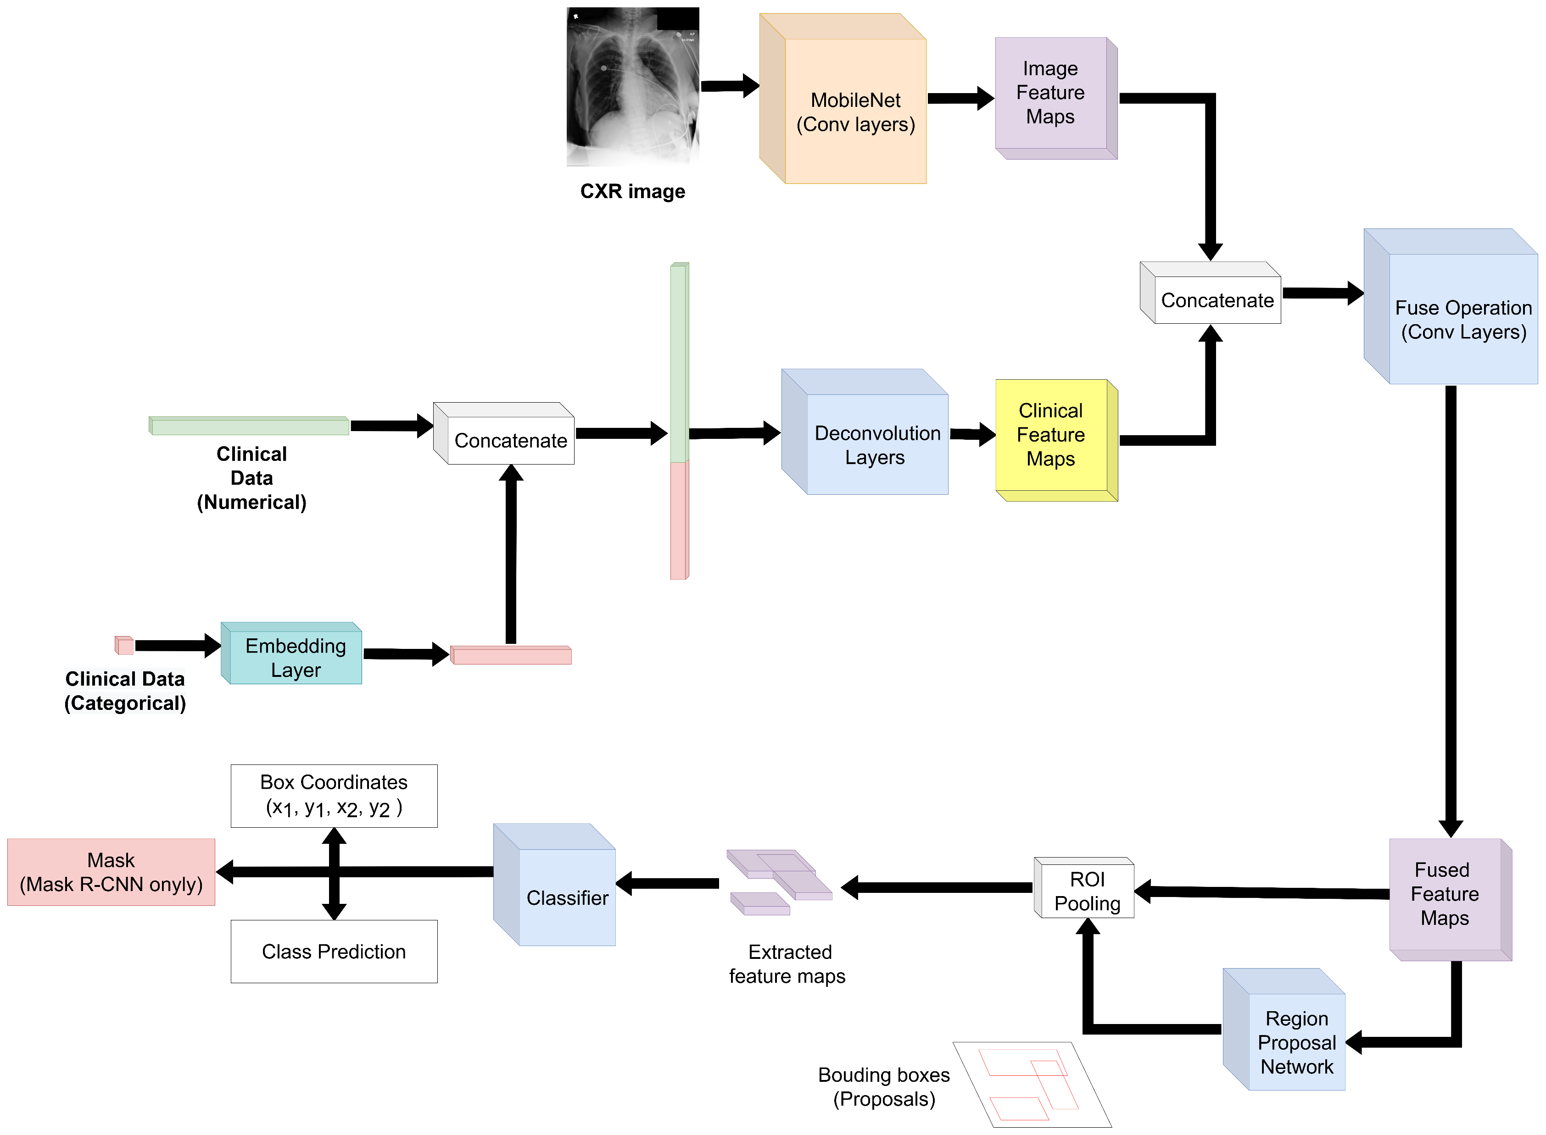
Architecture
The ground truth is appended to the “Proposals“. The RPN end up outputting unrealistic proposals, so the “Classifier” can easily identify what are those ground truths and use them to make prediction. And, this is only in the CXR+Clinical model.

Slide 3


CXR+Clinical model has this, because the losses.
These two values are too small
Loss_objectness (from RPN): the proposals have to contain abnormality.
Loss_rpn_box_regression (from RPN): proposals have to locate the abnormality precisely.
Loss_classifer (from Classifier): the classifier has to classify what’s inside the box.
Loss_box_regression (from Classifier): the final bounding boxes has to locate the lesion precisely.

Slide 4
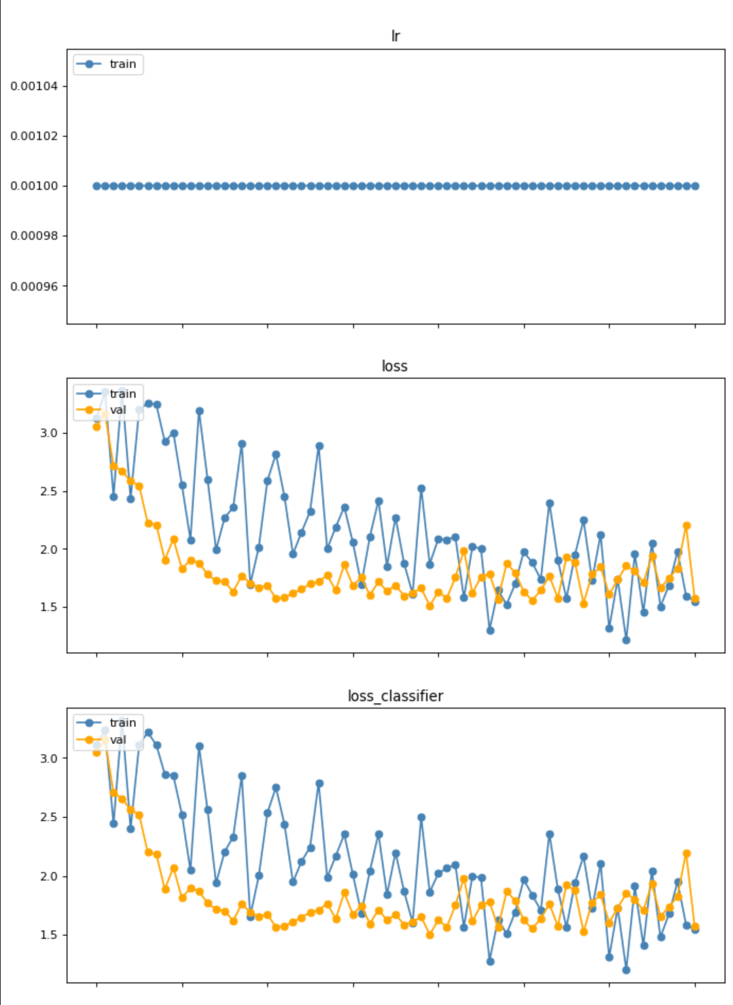
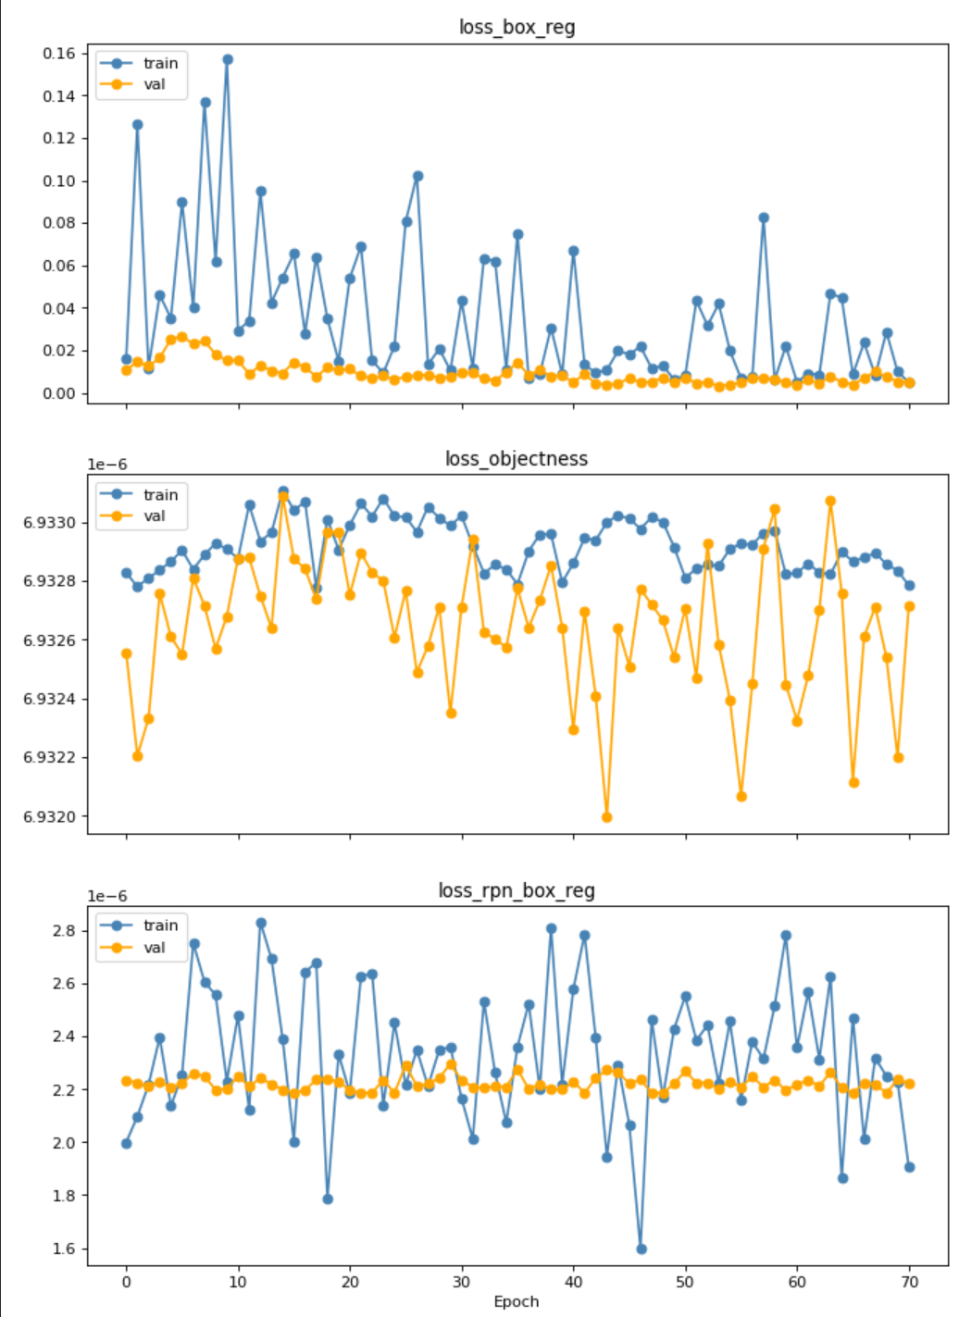


Not decreasing

Slide 5
Solution: Increase the weight of RPN loss.
Multi-Task Learning Using Uncertainty to Weigh Losses for Scene Geometry and Semantics
(https://openaccess.thecvf.com/content_cvpr_2018/papers/Kendall_Multi-Task_Learning_Using_CVPR_2018_paper.pdf)

Slide 6
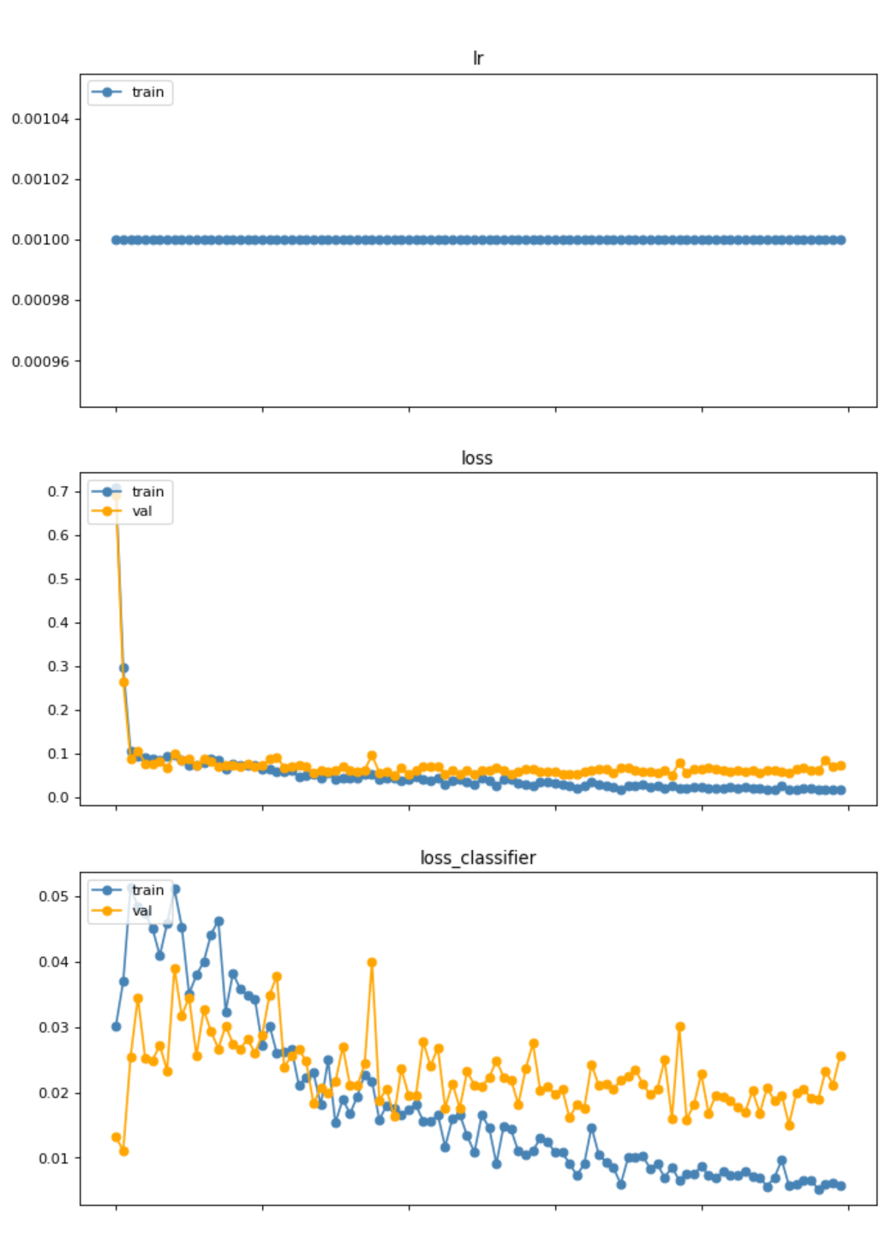
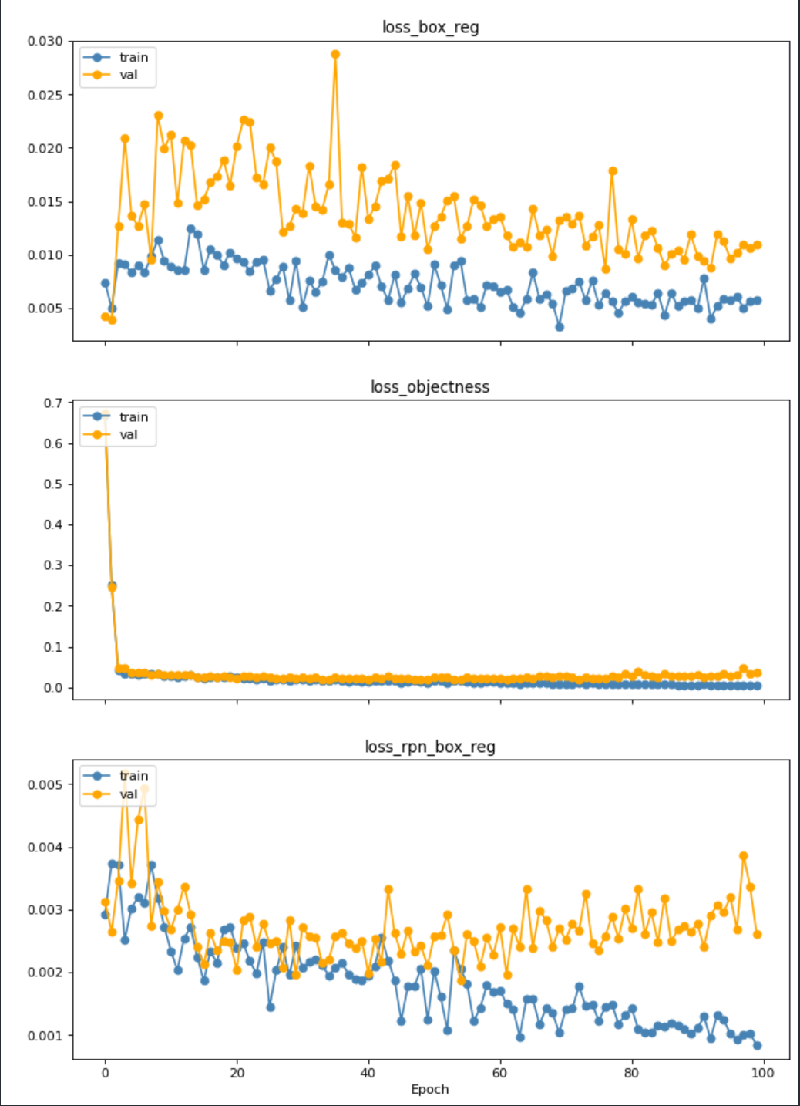
Dynamic loss (easier task first)

Slide 7
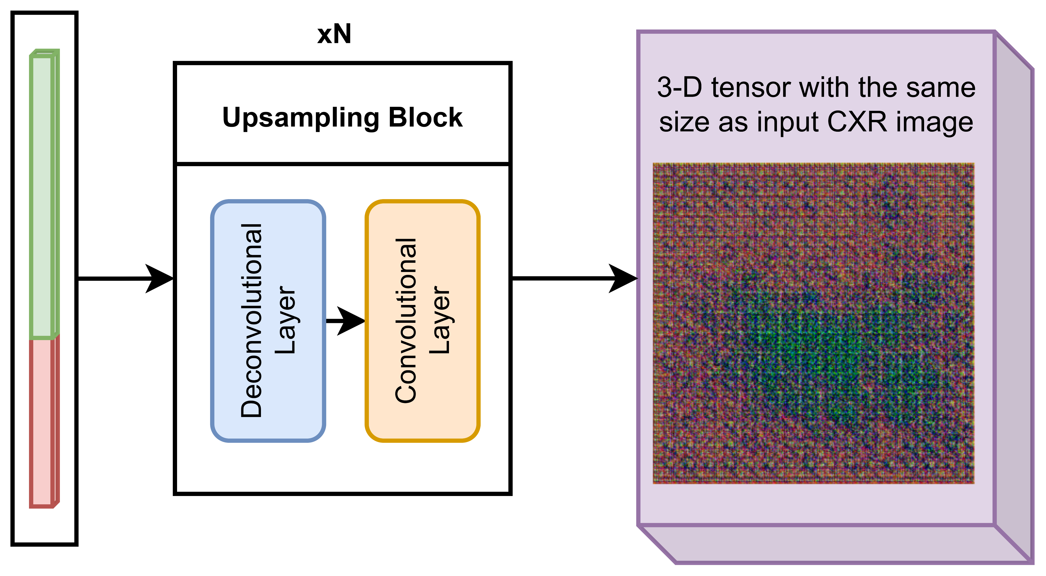
Architecture changes.
We had a lot overlapping bounding boxes, and this new architecture mitigate this issue

Slide 8
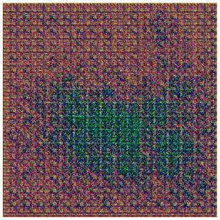
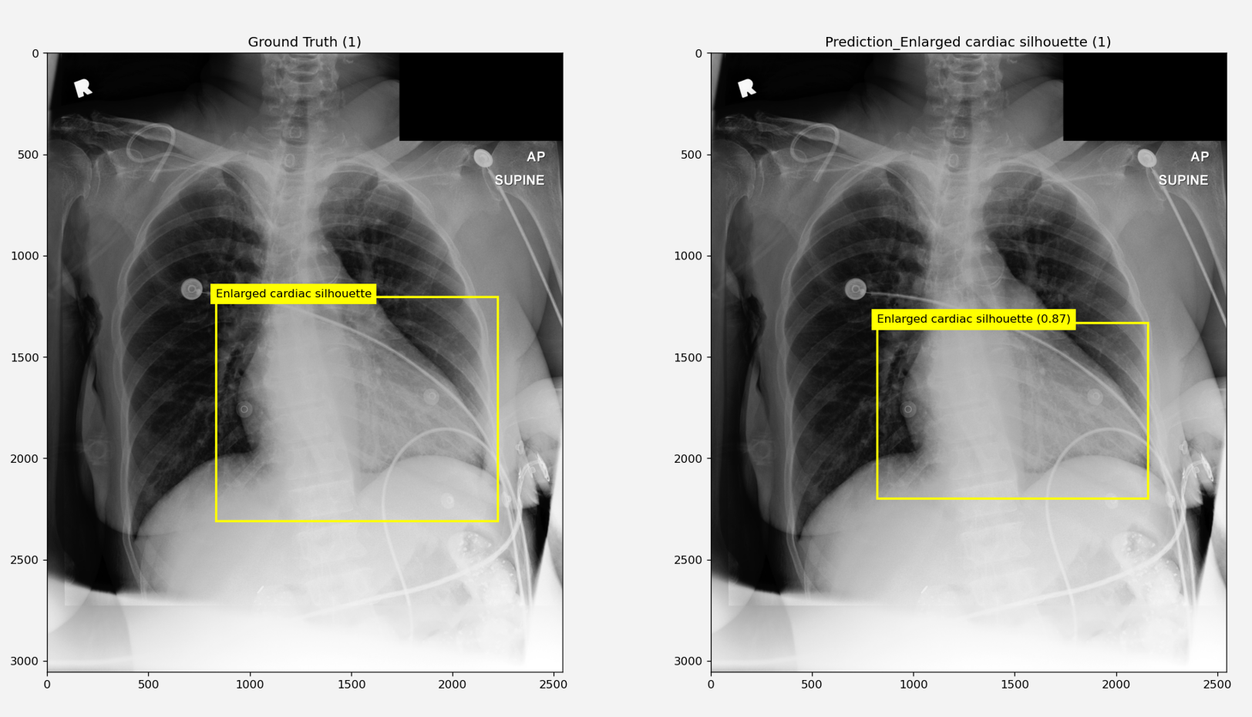

Slide 9
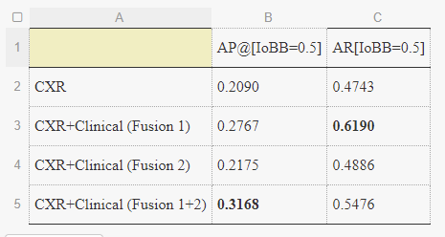
Current evaluation:

